Slide 1


Dongguan Aituo Medical Equipment Co., Ltd.
Product Specification
High Flow Nasal Cannula
(HFNC)

Slide 2


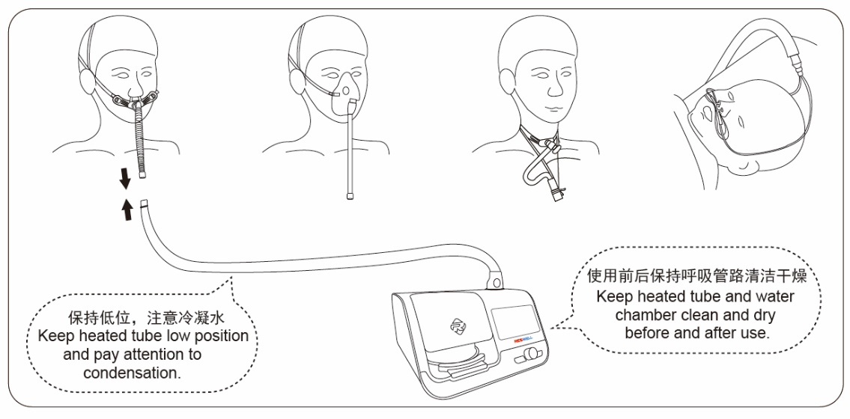
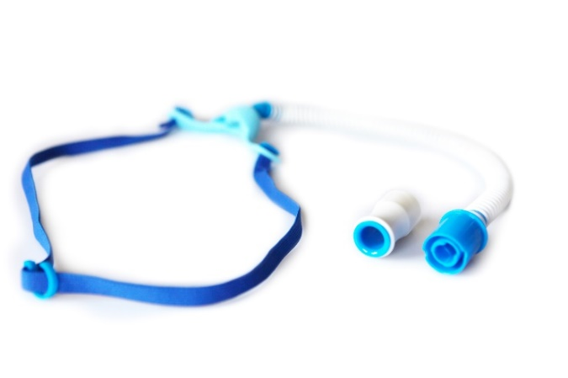
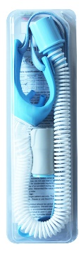
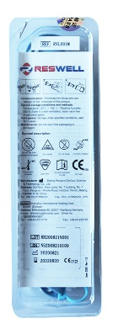
Dongguan Aituo Medical Equipment Co., Ltd.
Nasal Cannula Specification
Nasal Cannula specification (non-sterile supply)
Product | Prongs |  | Patient Weight | Resistance in 60L/min flow
 | Nostril spacing | Inner Diameter
AT001S | 8.0mm | 3.7mm | 30-50kg | 17cmH2O
AT001M | 9.3mm | 4.5mm | 50-70kg | 11 cmH2O
AT001L | 12.6mm | 5.1mm | ＞70kg | 8 cmH2O

Slide 3
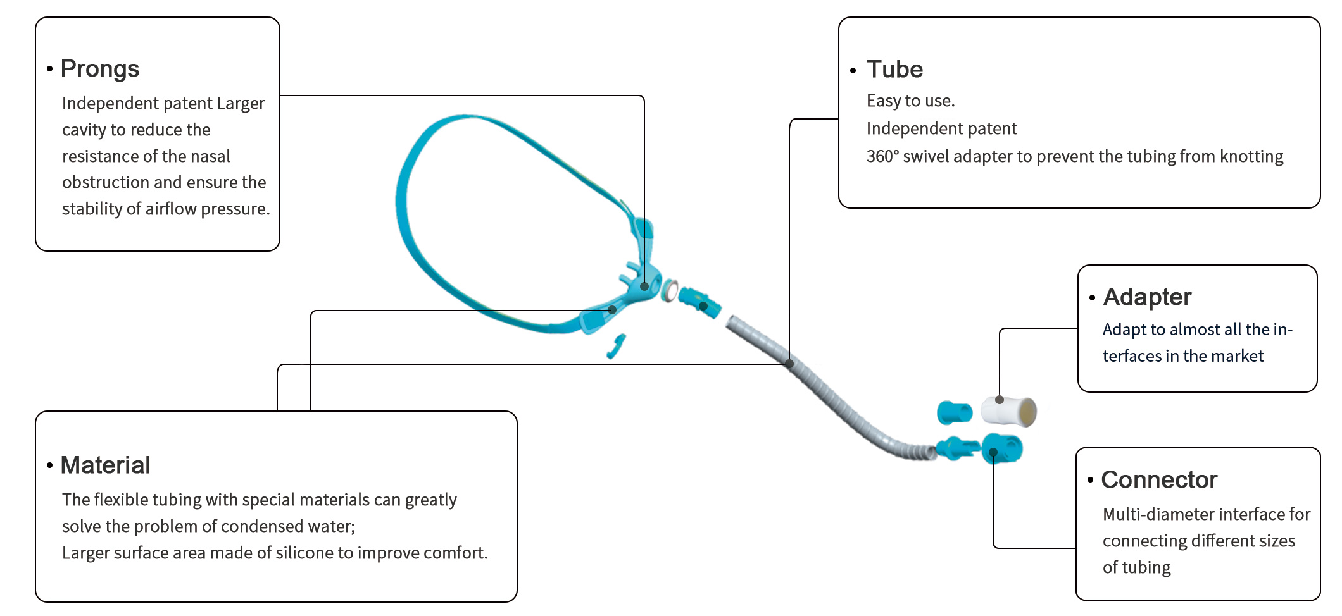
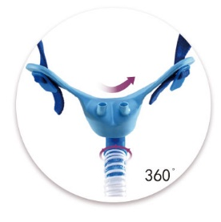
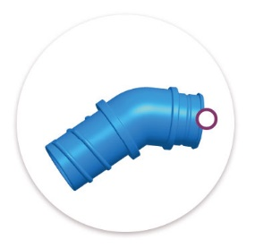
Dongguan Aituo Medical Equipment Co., Ltd.
Nasal Cannula Specification
4 boxes-carton-20pieces/box

Slide 4
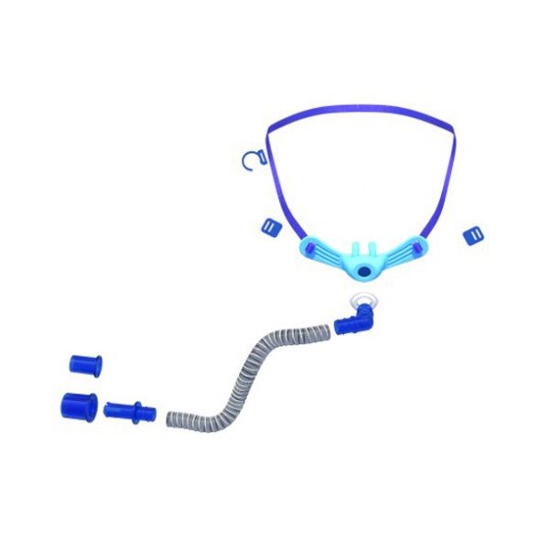
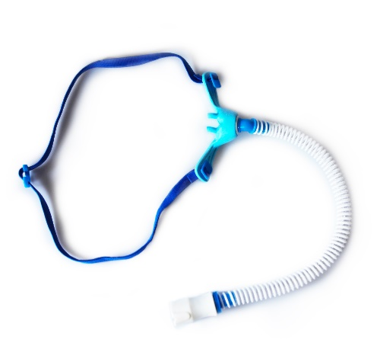
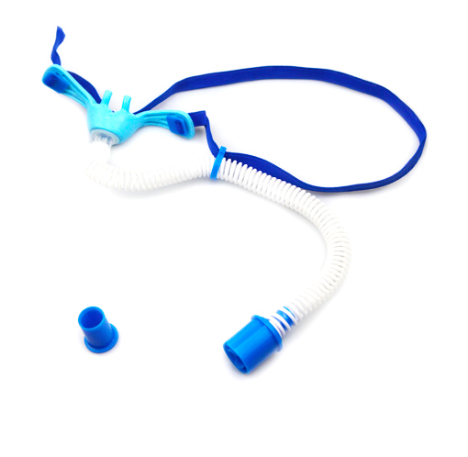

Dongguan Aituo Medical Equipment Co.,Ltd.
Features
HFNC plays an important role in the air transmission of nasal high flow therapy, which deliver hearted, humidified air and oxygen mixtures at flow rates up to 60L/min to the patient through the non-sealed nasal cannula.
HFN
Aituo Medical HFNC series can be widely used in respiratory department, RICU,ICU, emergency department , neurosurgery, cardiology etc, and in targeted therapy plan for respiratory failure, mild respiratory distress, mild ventilatroy dysfunction,etc.

Slide 5

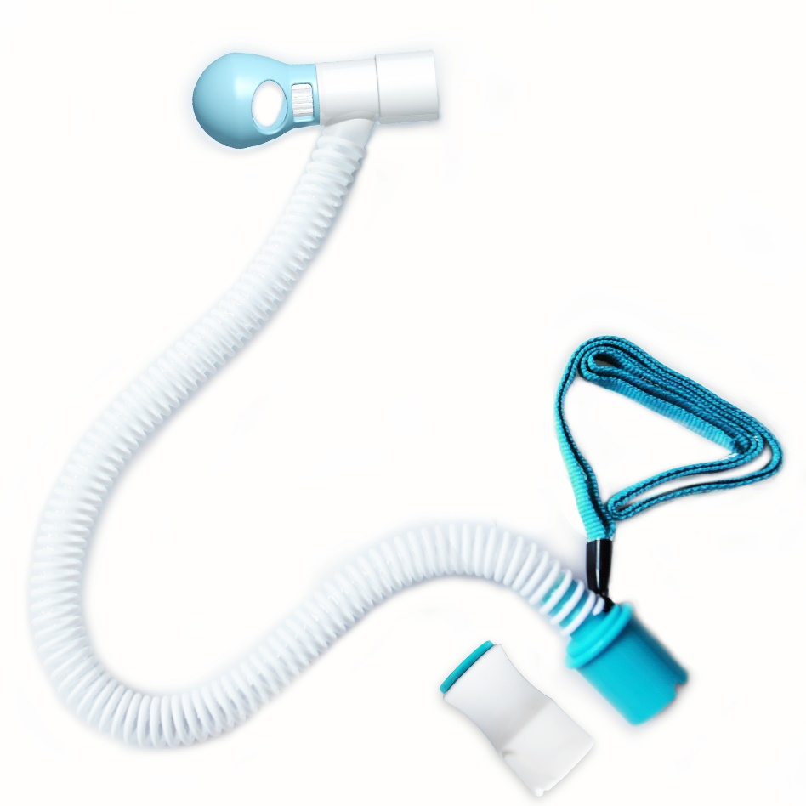
Dongguan Aituo Medical Equipment Co.,Ltd.
Tracheostomy Direct Connection
ATQ001
cover:
Mushroom head type anti-phlegm cover, effectively prevent phlegm splashing and pollution. Easy to plug and unplug, open sputum suction operation, easy to clean.
Adapter
Effectively increase the positive end-expiratory pressure and ensure that the positive airway pressure is open，
Vent grid patent:
Adjustable airway pressure and humidification effect
Lanyard:
Minimize the load and movement of the tracheal tube. Fix the tracheal tube correctly to avoid accidental extubation or damage to the airway.
Material：
The tube is made of special materials to reduce condensation.
Connector
a variety of interfaces can be selected, connecting almost all Tube joints.

Slide 6

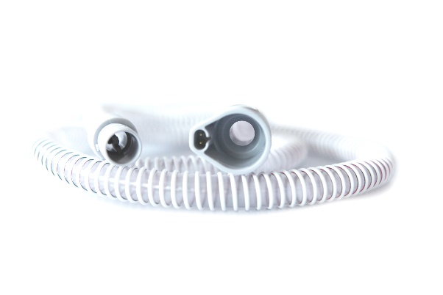
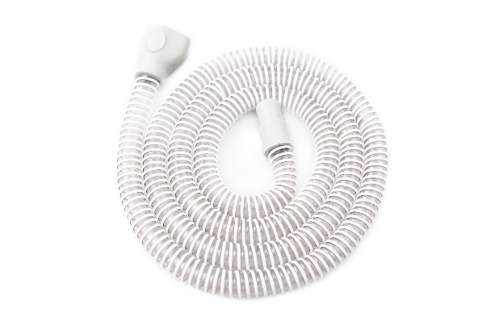
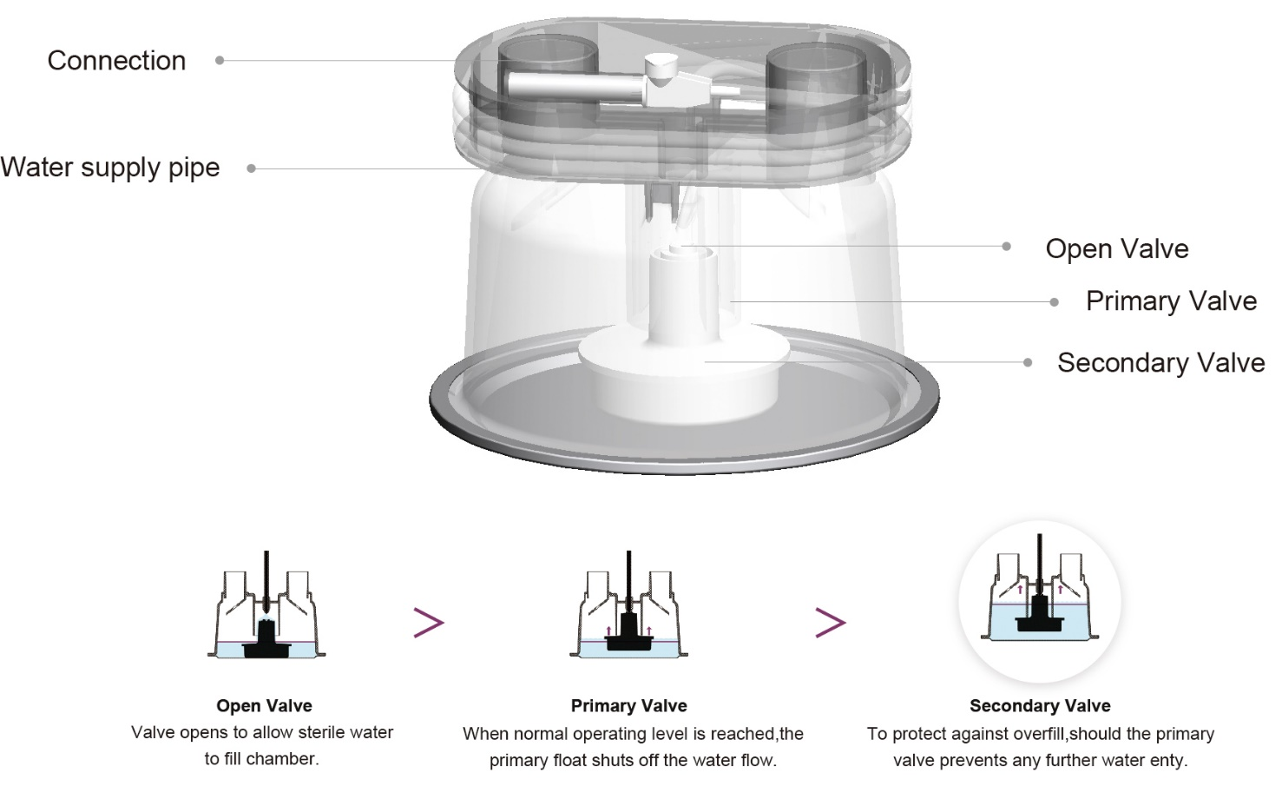
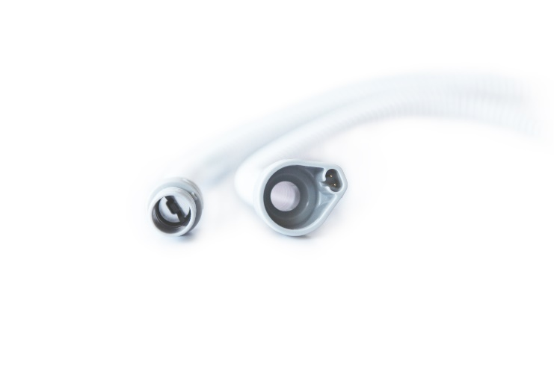
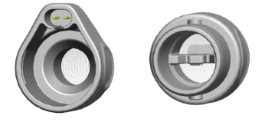
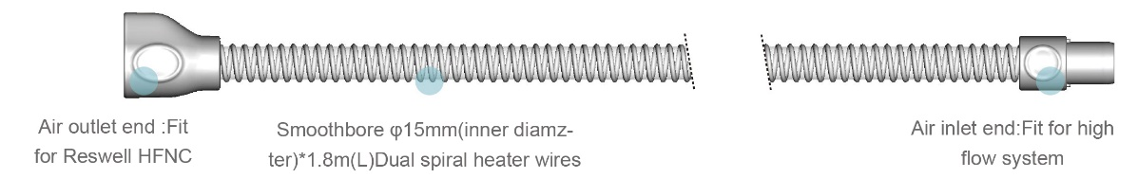
Dongguan Aituo Medical Equipment Co.,Ltd.
Water Chamber / Heated Tube

Slide 7
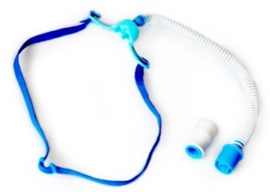

Dongguan Aituo Medical Equipment Co., Ltd.
Product Specification
Models | Picture | Description | Package & Weight
High Flow Nasal Cannula AT001S AT001M AT001L |  | Aituo Medical HFNC is designed to comfortably fit every one, regardless of facial shapes. Movable hook and 360° rotating seal helps to adapt to patient movement. | Weight: 40g Package Size:23*9cm Quantity per master carton: 100pcs Master carton size ：45*32*28cm 6.7KG
Tracheostomy Direct Connection ATQ001 |  | Scope of application: It is used for the gas connection of high flow humidification tube and tracheotomy casing. The main structural components of the product: air source connector, bellows, air outlet connector, sputum suction cover.
High Flow Nasal Cannula
AT002S
AT002M
AT002L

Slide 8

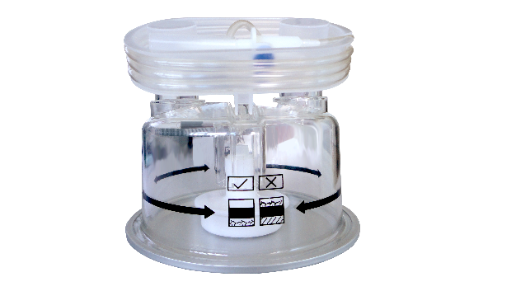
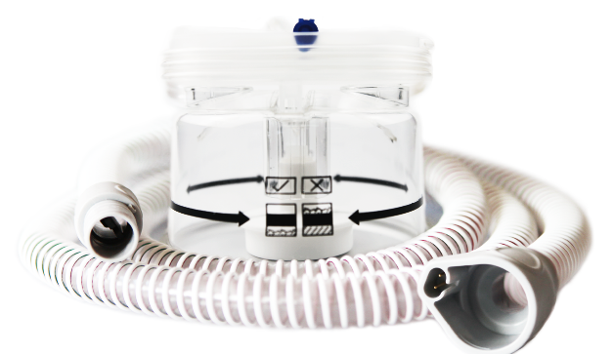
Models | Picture | Description | Package & Weight
Heated Tube ATH001 |  | Aituo Medical HFNC is designed to comfortably fit every one, regardless of facial shapes. Movable hook and 360° rotating seal helps to adapt to patient movement. | Weight: 110g Package Size:25*28*9cm Quantity per master carton: 80pcs Master carton size ：45*32*28cm
Water Chamber ATH001D |  | Scope of application: It is used for the gas connection of high flow humidification tube and tracheotomy casing. The main structural components of the product: air source connector, bellows, air outlet connector, sputum suction cover. | Weight: /160g Package Size: Quantity per master carton: 18pcs Master carton size ：45*32*28cm
Double Valve Auto-Fill Humidification Chamber/ Heated flexible tubing ATH002 |  | Double Valve Auto-Fill Humidification Chamber: Connected to the ventilator outlet or breathing circuit Universal diameter 22mm interface Heated flexible tubing: Smoothbore φ15mm (inner diameter)*1.8m（L） Dual spiral heater wires Air inlet end: Fit for F&P AIRVO2 Air outlet end: Fit for Aituo Medical HFNC | Weight: /270g Package Size: Quantity per master carton: 18pcs Master carton size ：45*32*28cm

